Slide 1


Code Challenge GIC ISPVMF Global Retreat 2017
Notes:
E1/E2 - Good Morning, I am <> and I am <>.
E1 – Welcome to the first day of the ISMPVMF retreat and your retreat committee has planned for you an interesting workshop – The code challenge.
E2 – Are you sure you are in the right place – this is not a TD retreat, what is coding doing here? It’s I-S-P-V-M-F you know?
E1 – Yes yes, I know it’s quite happening right? But this has been planned very much for this fantastic group of ISPVMF people.
Today, you will be writing some real code to power a Rebot, a simple chatbot that you talk to on your very own phone.
E2 - You may think today’s session is a lesson on programming. But no, prior coding skills or experience is not needed.
Today is about showing all of you a little code, but to expose the logic and analytical thinking process behind it.
At the end, your team can challenge others to win prizes with pure logic.

Slide 2
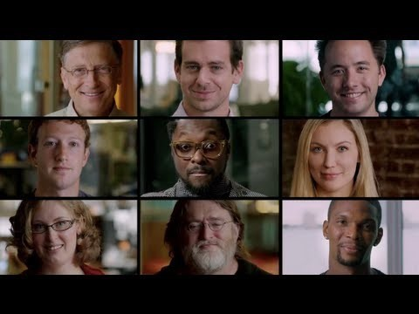
Yup, Everyone Can Code!
Notes:
(Pre-video) Now here’s a short video featuring people from diverse backgrounds like sports, musicians, CEOs, etc. sharing about programming.
(Post-video) This video demonstrates the simple point that everybody can and should learn programming. Today’s session is about giving you a start on this journey.
https://rebot.chat/materials/code-video.mp4
https://www.youtube.com/watch?v=jJkVRM-tUQA

Slide 3
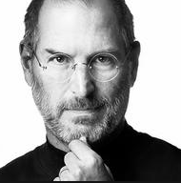
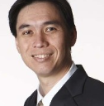
“
Everybody in this country should learn how to program a computer…because it teaches you how to think.
- Steve Jobs
”
“
The core skills that programing brings out in every one of us is logical/analytical thinking and the ability to solve problems in a creative manner.
- Hoe Yin
”
Notes:
The famous Steve Jobs once said:…
The equally famous personality in GIC circles has said….
So let’s look forward to a fun-filled session to gain some handy coding skills which has a potential to blossom into a core skill for you to be Future Ready in the tech-driven business model.

Slide 4
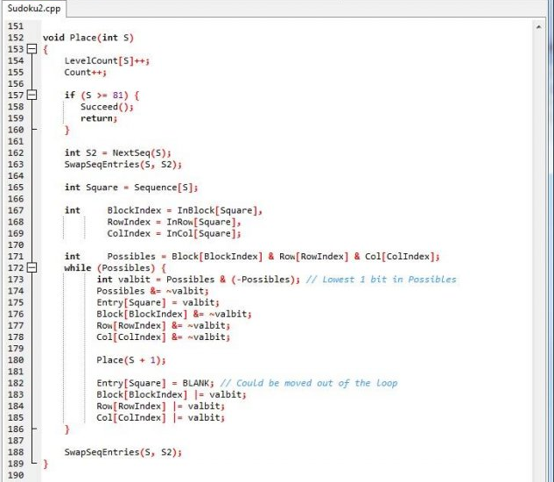
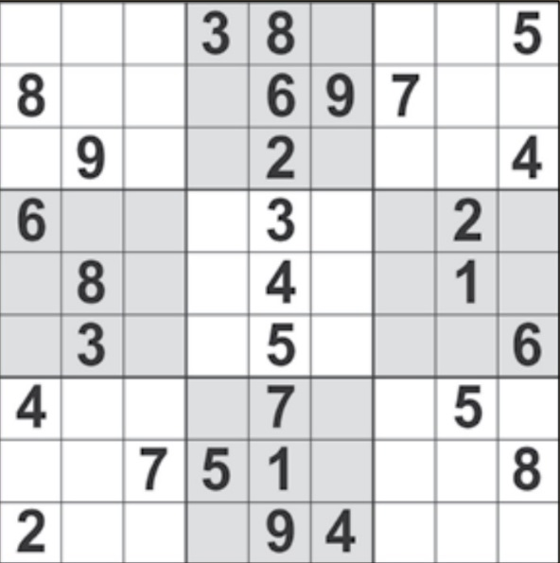
So, Guess Who Wrote This?
Notes:
Ask & Pause for a while to see if anyone makes some guesses..

Slide 5
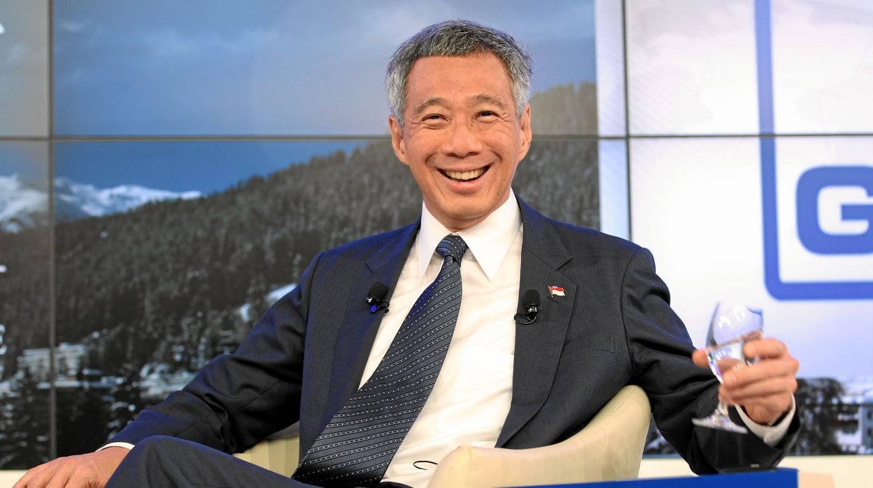
“
”
I used to enjoy this; it is a long time since I’ve done anything.
The last program I wrote was a Sudoku solver in C++ several years ago, so I’m out of date.
- Prime Minister Lee Hsien Loong

Slide 6

Aim
Basic
Introduction
To Coding
- Basic Python
- Web scraping
Most Importantly
Get to
Know
One
Another Better
Notes:
Objectives of today.
To learn a bit about coding
Also for you to get the opportunity to know people around you better.
And, most importantly, have fun! It’s a retreat afterall ☺

Slide 7
Plans
Appetiser
11:15-11:30 - Introduction
11:30-12:30 - Baby Python
12:30-1:00 - Lunch Break
Main Course
1:00-1:30 – Say Hello to ReBot
1:30-2:30 – Taming the Python
2:30-4:00 – Rebot Challenge
4:00-4:30 – Short Break
Dessert
4:30-5:15 – Idea Generation and Pitch preparation
5:15-5:30 – Move to 38 Auditorium
5:30-6:15 – Pitch, Awards and Closing
Notes:
Here’s the agenda for today

Slide 8
Get Ready!

Slide 9
Why Code?
10 minutes
Notes:
Why learn how to code? And how can it benefit you?

Slide 10




Notes:
Wonderwoman for equality. The S represents both superboy and supergirl

Slide 11
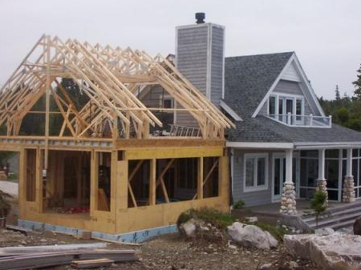
Notes:
If someone wants to do renovation on your house, would you want to leave it with the person for 6 months? Or would you want to know exactly what the builder is going to change?

Slide 12
Stop. Think of Logical Blocks
Let’s get a computer to do things.
But,
The machine is a fast worker but very stupid
“Please, make me a sandwich!”
Will this work?
Step 1: Take a slice of bread, put it on the board
Step 2: Apply a 1mm layer of butter on the bread
Step 3: Take a slice of ham, put it on the bread
Probably closer to this,
Step 1: Move arm to coordinates (49, 50, 0) with power 1W
Step 2: Move arm down to (49, 50, -40) with power 1W
Step 3: Tighten fingers with power 2W
Notes:
Process of breaking down problems

Slide 13
Python?
Uh.. Eating a snake?
45 minutes
Notes:
So whats python? Are we going to eat snake today?

Slide 14
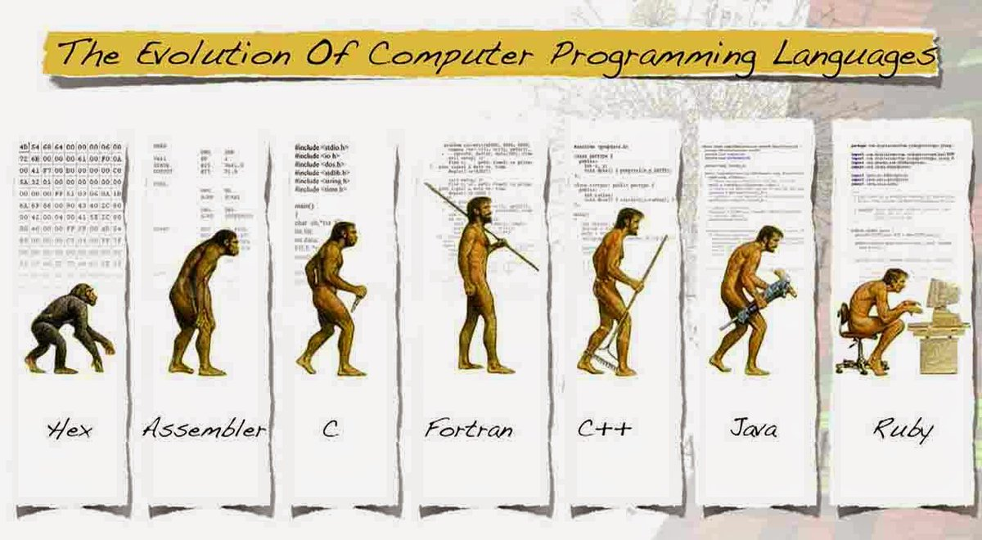
What Exactly is Python?
Considered a Fourth Generation Language
Simple & mighty for mathematical libraries
Relatively “natural” to read
Python!
Notes:
To tell them that programming languages have also advanced. Its not always like it used to be.

Slide 15

Visit Rebot.Chat
Type rebot.chat in your web browser
Notes:
Visit this site if they havent

Slide 16
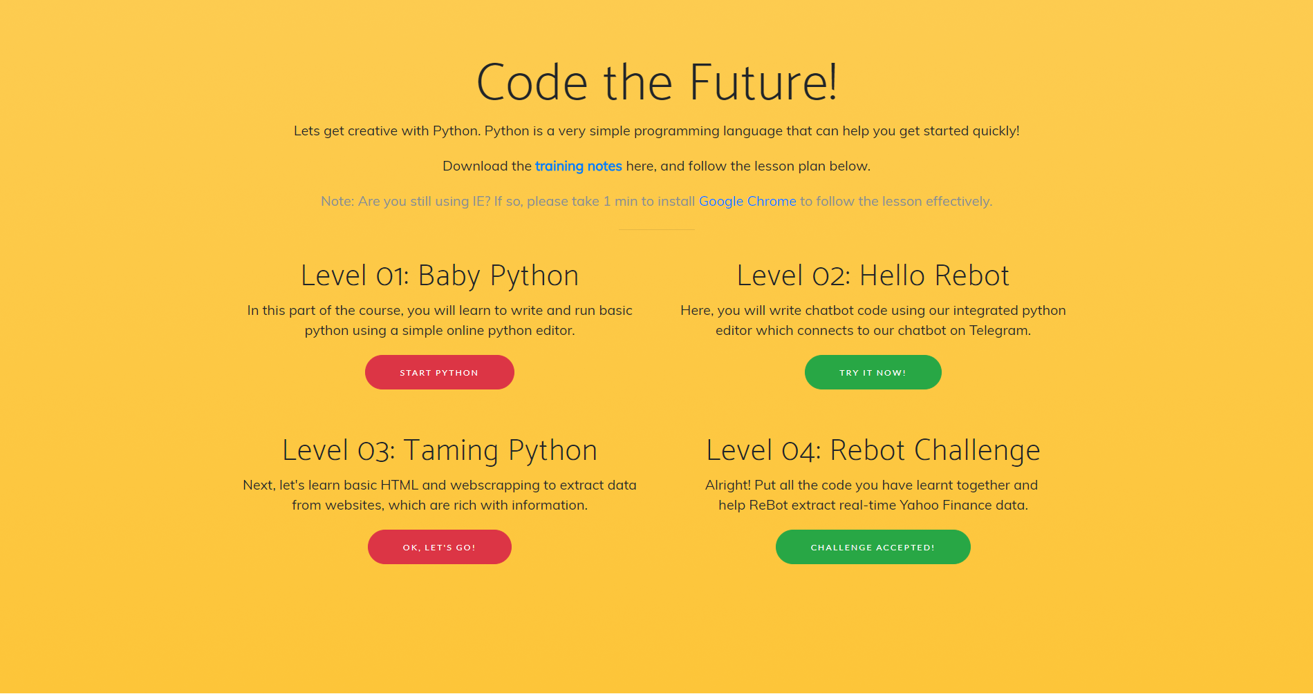
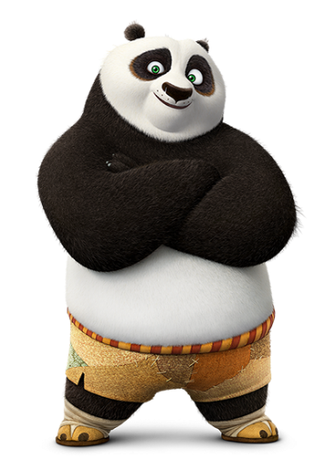
Notes:
See trainer-guide – Level 01

Slide 17
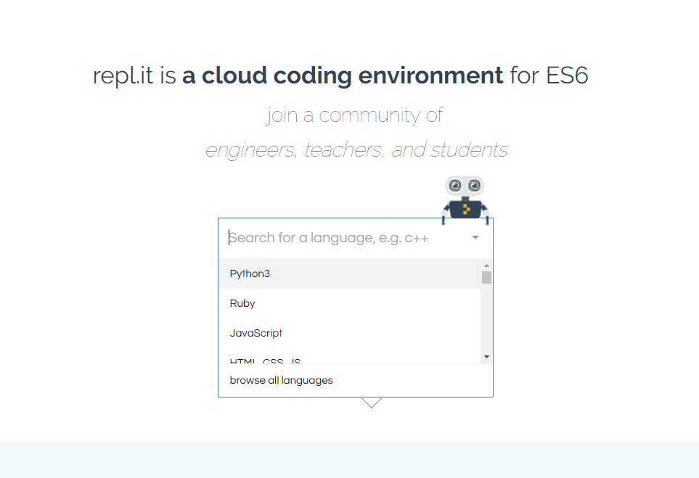
REPL: Basic Online Python Editor
Select “Python3”
Notes:
See trainer-guide – Level 01

Slide 18
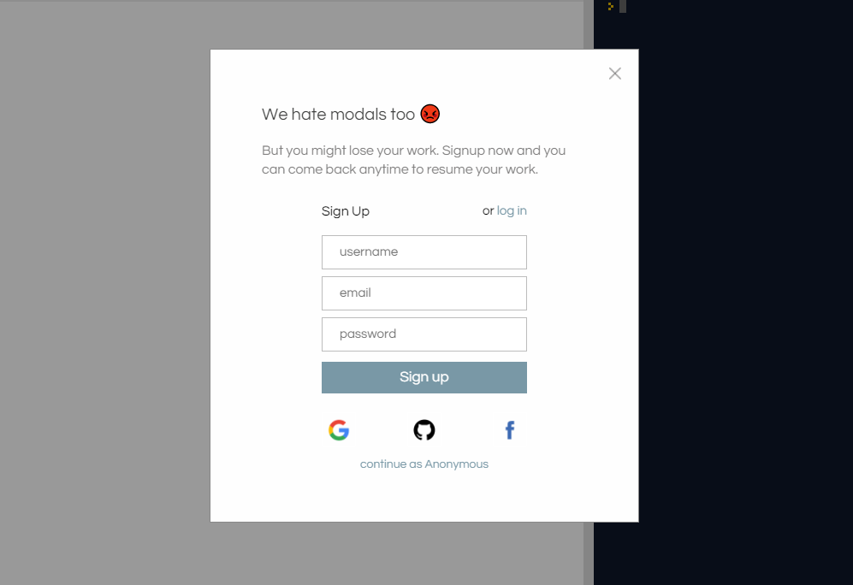
REPL: Basic Online Python Editor
Select “Continue as Anonymous”
Notes:
See trainer-guide – Level 01

Slide 19
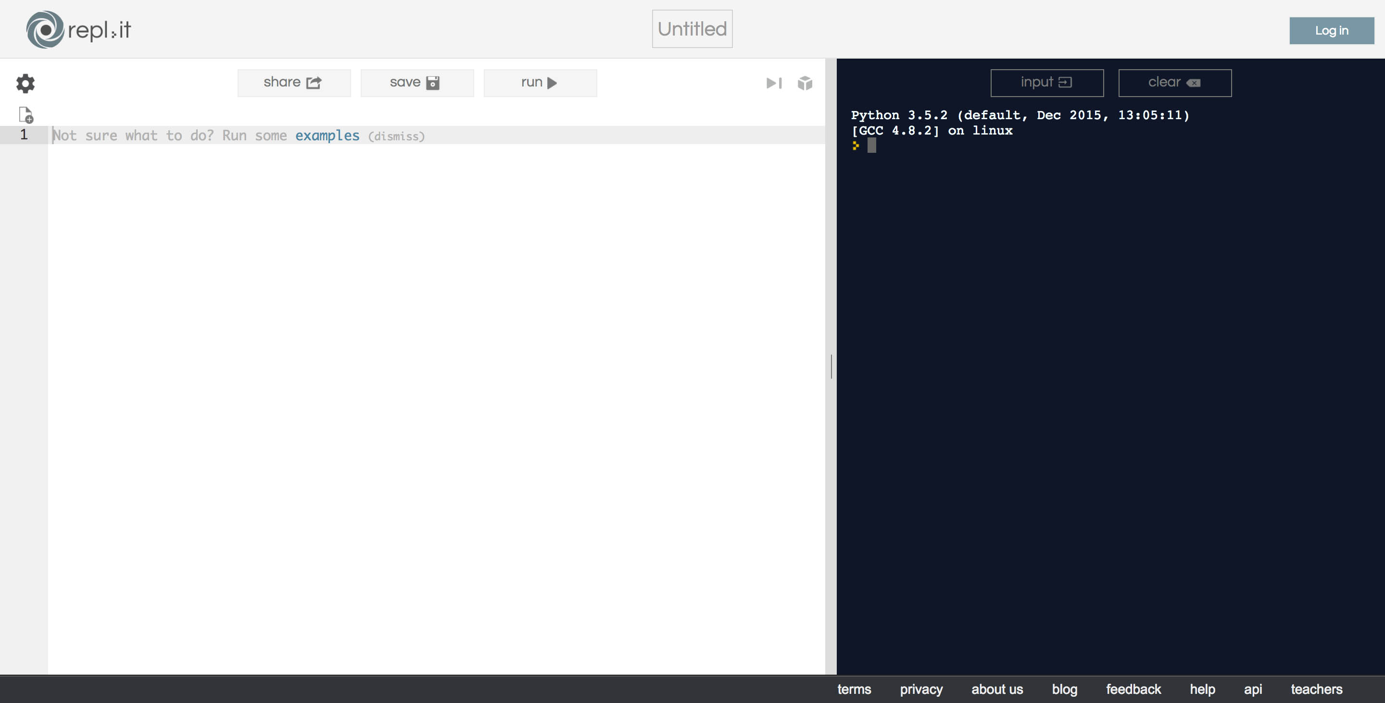
REPL: Basic Online Python Editor
(Left-Hand Side)
Write code here
(Right-Hand Side)
See output here
Notes:
See trainer-guide – Level 01

Slide 20
REPL: Basic Online Python Editor
Run your code
Save your changes
Notes:
See trainer-guide – Level 01

Slide 21
Real Code! Step-by-Step
Appetizer
Print(“Hello World”)
Concept of variables (containers)
Create a string variable “name”
Print “Hello, my name is …”
Main Course
Concept of variable types
String (text) – What is “1” + “1” ?
Integer (whole numbers) – What is 1 + 1 ?
Float (represented with decimals)
Concept of (IF .. THEN .. ELSE)
Dessert
Recap + Free-to-play
Notes:
See trainer-guide – Level 01

Slide 22
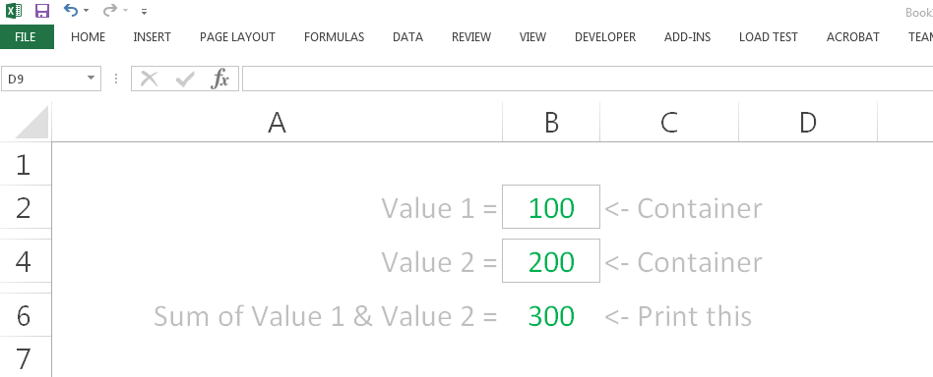
Hey wait, isn’t this familiar?
Excel Formulas
Describe outcome with expressions
Cell = IF(SUM(A:A) > 1, SUM(A:A), “No”)
Excel Worksheet Cells
Think of “Cells” like “Containers”
I am an Excel Worksheet
Notes:
Bring audience back to their daily work. Excel that they are familiar with.
So they could already have been doing this unknowingly.

Slide 23
Logical Design >> Code
Coding easy to learn (And, can be fun ☺)
Following a recipe: EASY
Creating a recipe: HARD
Given set of values: 5, 9, 10, 4, 11, 3, 6
Highest and lowest number?
What’s your recipe?
Don’t just translate your work procedures
Simplify and refine it.
Notes:
Not the code that is important. The Logic is the critical part

Slide 24

Golden Quotes
“
The core skills that programing brings out in every one of us is logical/analytical thinking and the ability to solve problems in a creative manner
- Hoe Yin
”
Notes:
Bring back to the logic/analytical thinking -> to solve problems in a creative manner

Slide 25
Lunch-Break
12.30pm – 1.00pm
30 minutes

Slide 26
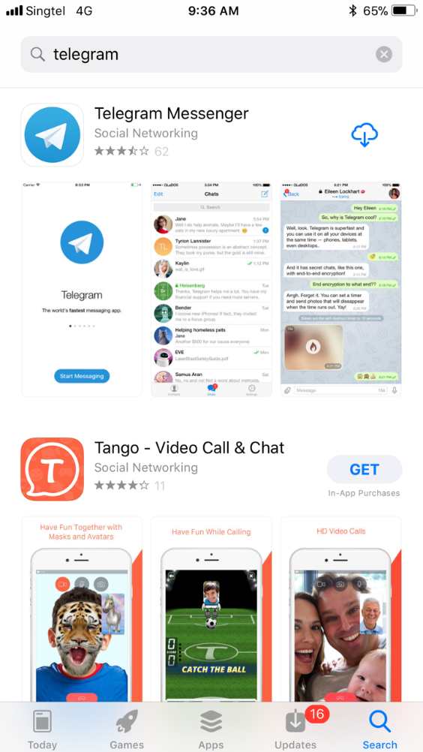





Step 1: Install Telegram

Slide 27
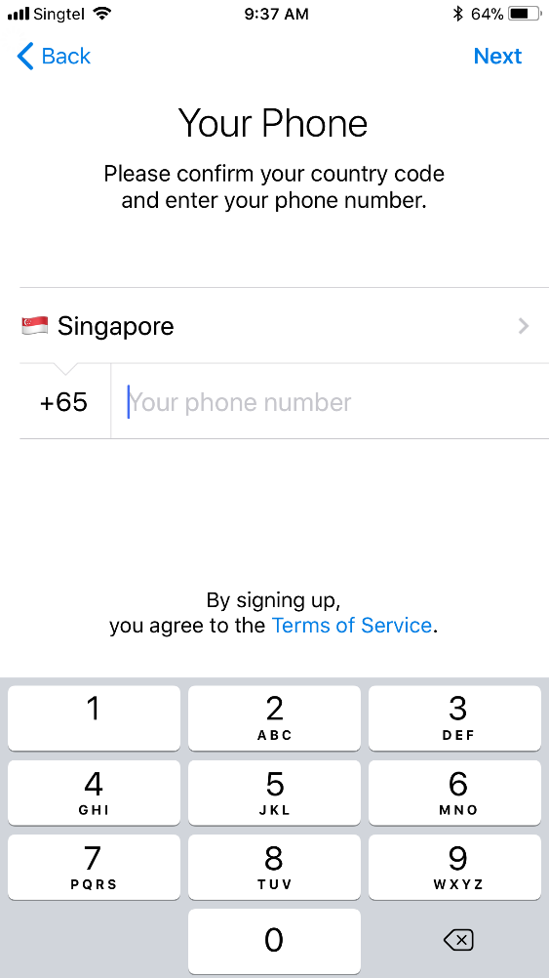
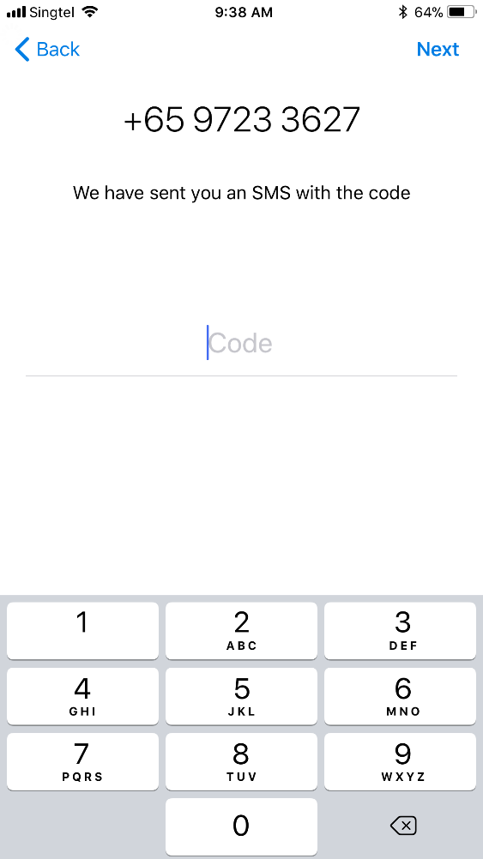
Step 2: Register Account
Register for an account
Wait for an SMS passcode
Key in the passcode
Your Phone Number

Slide 28
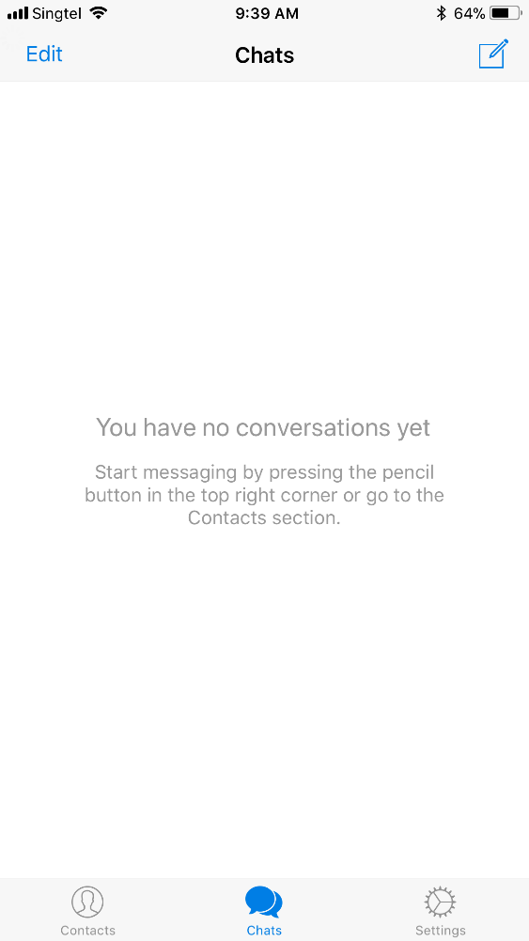
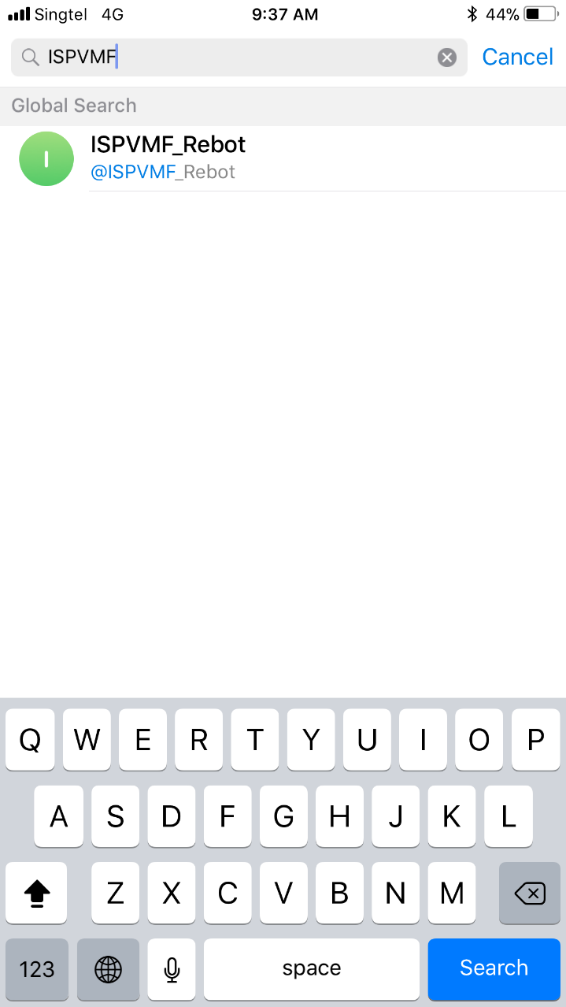
Step 3: Add @ISPVMF_ReBot
Add a Chat
Search for @ISPVMF_Rebot
Select @ISPVMF_Rebot

Slide 29

Rebot
Putting it Together For the First Time
30 minutes

Slide 30
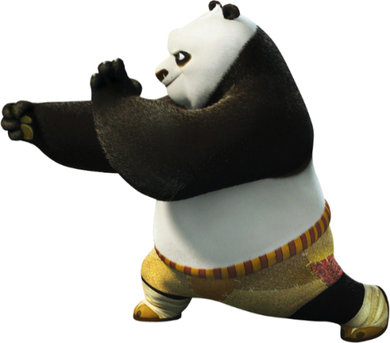
Notes:
See trainer-guide – Level 02

Slide 31
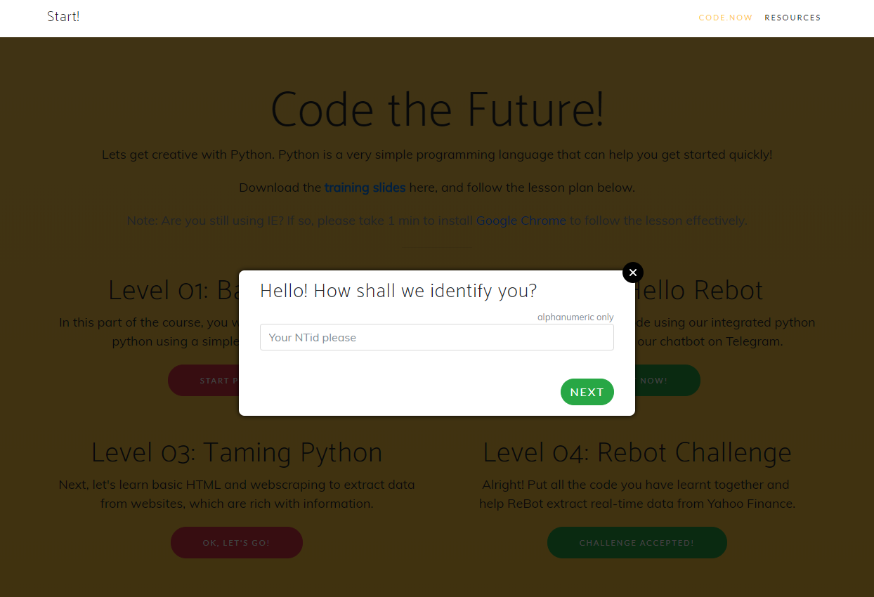
Choose an identity (alphanumeric)
Notes:
See trainer-guide – Level 02

Slide 32
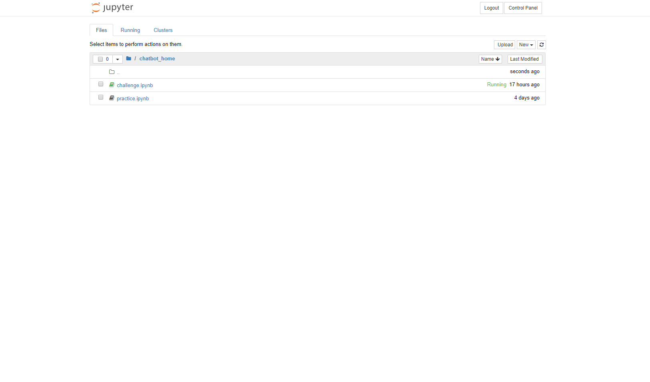
Jupyter: Integrated Python/Rebot
Click on practice.ipynb to start with the tutorial
Jupyter has been integrated
with @ISPVMF_Rebot
on Telegram
Next, lets see how your code changes on Jupyter
appear magically (hopefully) on your mobile phone
Notes:
See trainer-guide – Level 02

Slide 33
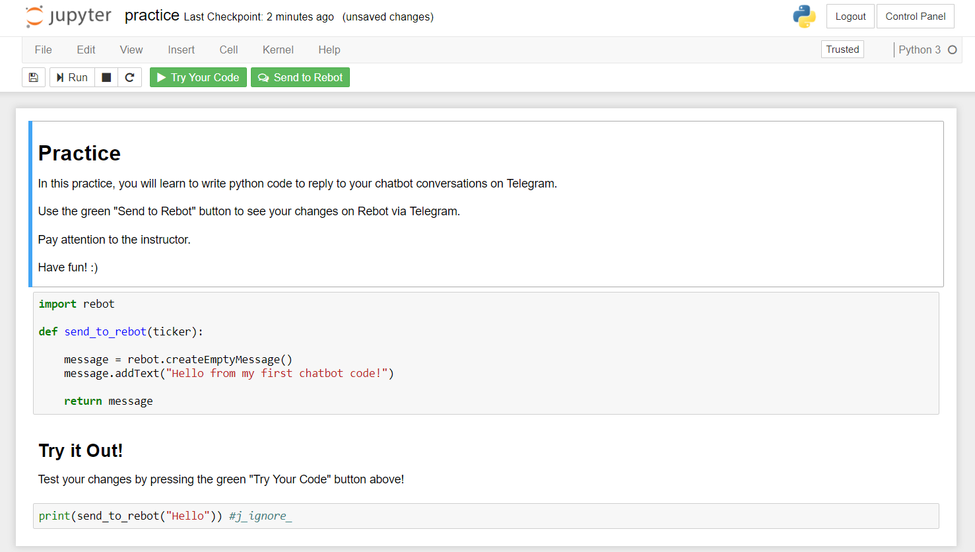
Jupyter: Integrated Python Editor
Two Buttons
Try Your Code
Send To Rebot
Write your code in this grey box area
Notes:
See trainer-guide – Level 02

Slide 34
Let the Magic Happen
Appetizer
Return “Hello World”
Return “Your Name”
Main Course
Lets make our chat bot smarter.
Return Sum (1 + 1)
Return (IF .. THEN .. ELSE)
Dessert
Return random results.
What is the day today?
What is your name?
I am bored?
Notes:
See trainer-guide – Level 02

Slide 35

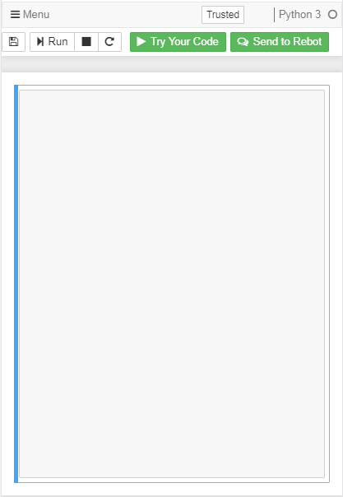
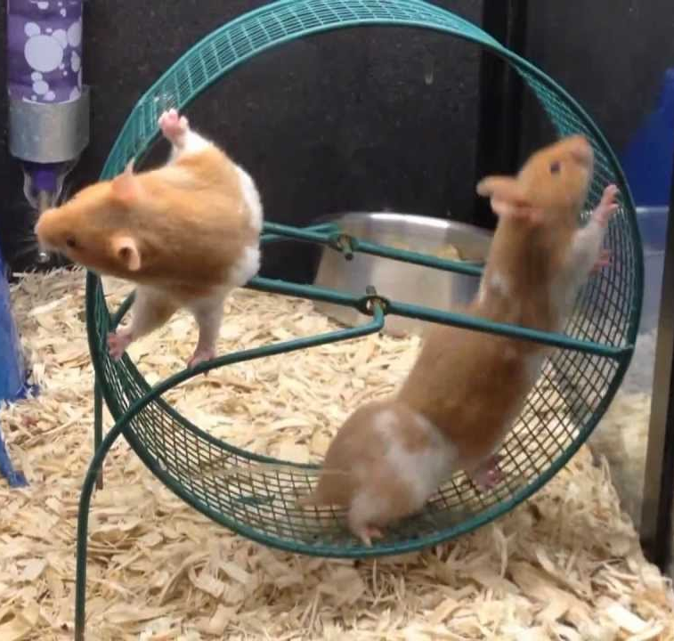
How does Rebot work?
Your Chat
Your Code
Messages
Chatbot UI
Data Logic
Messages

Slide 36
Web-scraping
Scrape Data From Websites
60 minutes

Slide 37
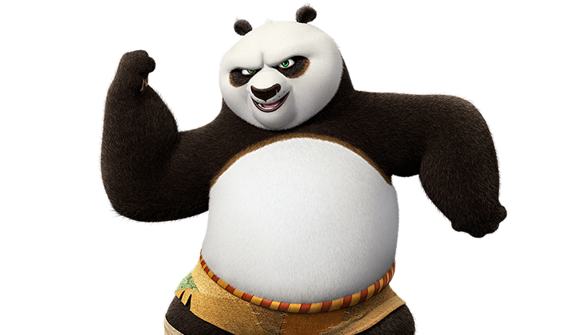
Notes:
See trainer-guide – Level 03

Slide 38

What is HTML?
HTML is
The building block of websites.
Source code of the Web
Concept of HTML Tags
Open tags <HTML>
Close tags </HTML>
Let’s see how to scrape data from HTML
HTML

Slide 39
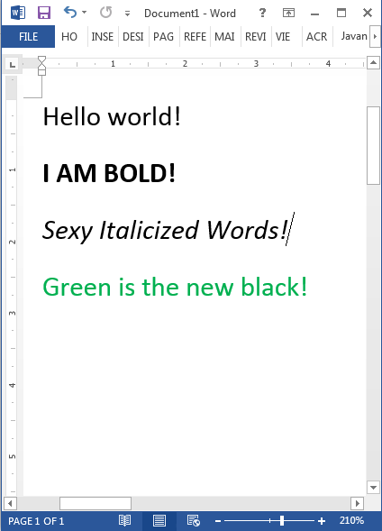
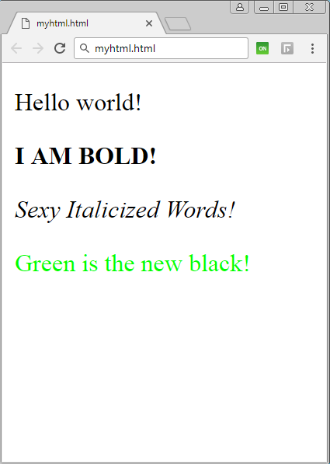
Word Doc vs HTML Doc
Word Document
HTML Document
Notes:
Bring them back to similarities between a Word Document and HTML

Slide 40
Word Doc vs HTML Doc
Word Document
HTML Document

Slide 41
HTML - Code Visualization
HTML - NESTED CONTAINERS
HTML - CODE BLOCKS
HTML - RAW CODE
Container (HTML)
<HTML>
</HTML>
<HTML>
<BODY>
<P CLASS=“Text”>
Hello World! </P>
</BODY>
</HTML>
Container (BODY)
<BODY>
</BODY>
Container (P)
<P CLASS=“Text”>
Hello World!
</P>
These values are enclosed in tags (think of containers).
They are the basic building blocks needed used to build basic to complex websites.
Notes:
HTML tags just define containers, and containers within containers. Kinda like inception the movie. If anyone has watched it

Slide 42
Word Doc vs HTML Doc
Word Document
HTML Document
Notes:
So lets revisit this page

Slide 43
Word Doc vs HTML Doc
Hey! HTML is just made up of TAGs
<html>
<body>
<p>
<p>
<p>
<p>
</body>
</html>
</p>
</p>
</p>
</p>
Hello World!
<b>I AM BOLD!</b>
<i>Sexy Italicized Words!</i>
<font color=“green”>Green is the new black!</font>
Notes:
Now see the HTML code

Slide 44
Think of Tags as Containers
Think of a
HTML TAG
As a
CONTAINER
I AM A VALUE
Notes:
Important slide for visual cue.
Give a pause in presentation before turning the TAG into CONTAINER

Slide 45
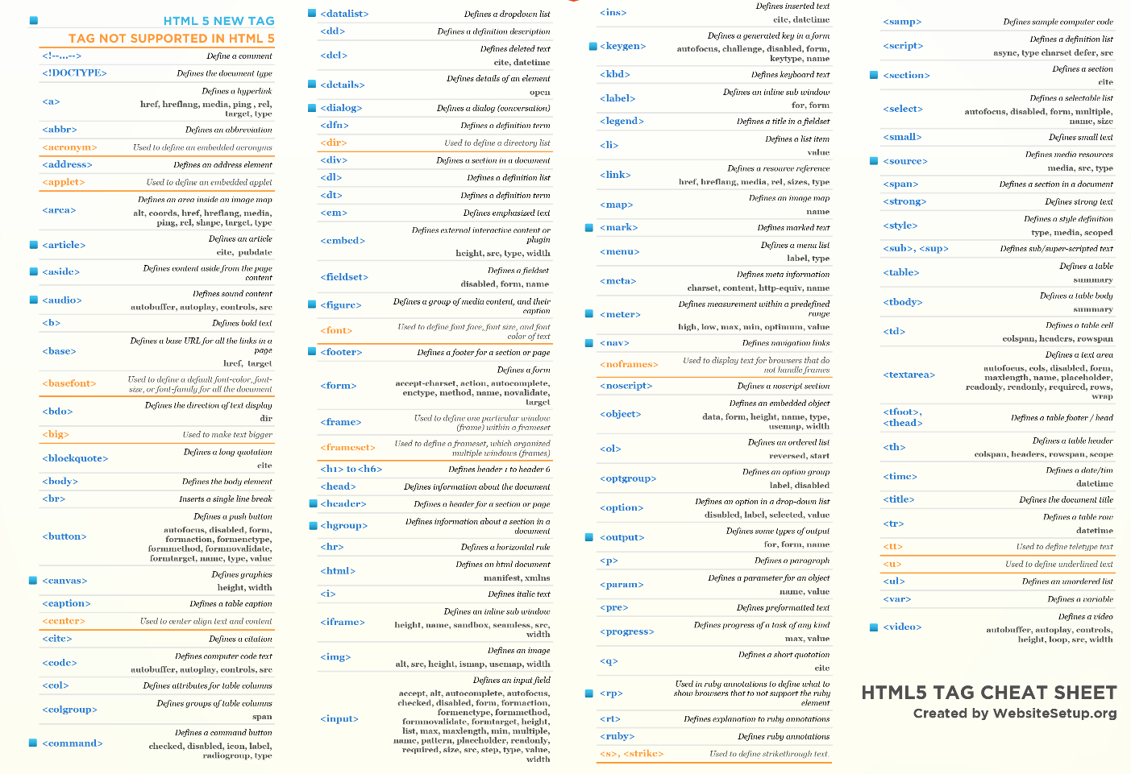
So many types of HTML tags…
For
Illustration Purposes Only
Notes:
So many different TAGs

Slide 46
Useful Tags for Today
Never fear! Only need these today.
<html>
<body>
<p>
<span>
<td>
<div>
</html>
</body>
</p>
</span>
</td>
</div>
Notes:
Only need these for today.

Slide 47
Notes:
Go back to rebot.chat & click Level 03
See trainer-guide – Level 03

Slide 48
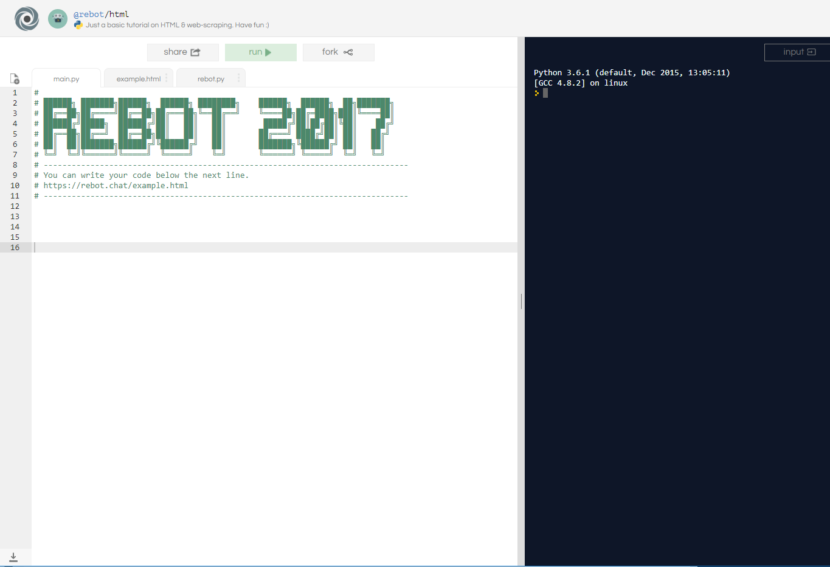
Let’s Give it a Try
Click on “Fork” to make a copy of the tutorial
Notes:
See trainer-guide Level 03

Slide 49
Let’s Give it a Try
You should see three files:
main.py
example.html
rebot.py
Notes:
See trainer-guide Level 03

Slide 50
Let’s Give it a Try
Step 1: Import libraries
Coders in the community can create libraries of commonly used features. These templates are pre-defined and can help us simplify and reuse code.
Step 2: What is the document filename? For example. “Quarterly reporting.doc”, “Mydocument.html”, http://rebot.chat/index.html.
Step 3: Get the content within the document
Extract the file content as bytecode literals directly from the document.
Step 4: Format the content into a proper HTML format
Creates a clean HTML format of the content, which is then readable by the extraction logic.
Step 5: Find the data-point we need
Use the rebot library to search for the container that we need, including any specific class properties into the search criteria
Notes:
See trainer-guide Level 03

Slide 51
Let’s Give it a Try
# Step 1: Tell python that you want to use rebot library.
import rebot
# Step 2: Keep the filename in a variable (ie. container)
filename = "example.html"
# Step 3: Ask rebot to give you the contents in the file
content = rebot.getContent(filename)
# Step 4: Ask rebot to convert the content to proper HTML
html = rebot.getHtml(content)
# Step 5: Search for the container in the HTML
data = html.search("span", "class", "target")
# Finally! Show the data
print(data)
Notes:
See trainer-guide Level 03

Slide 52
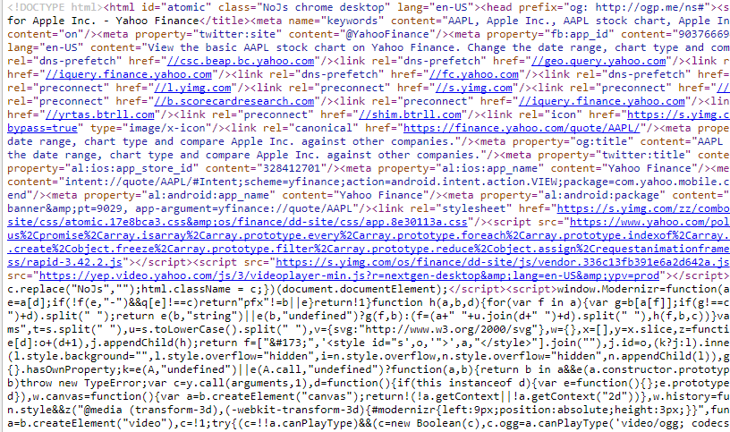
Often, its not so easy..
Example: HTML code behind Yahoo.com
Notes:
Close off the hands-on session.
In reality – its not so easy. Many websites are complex, dynamic and have mixed codes and templates to generate.

Slide 53
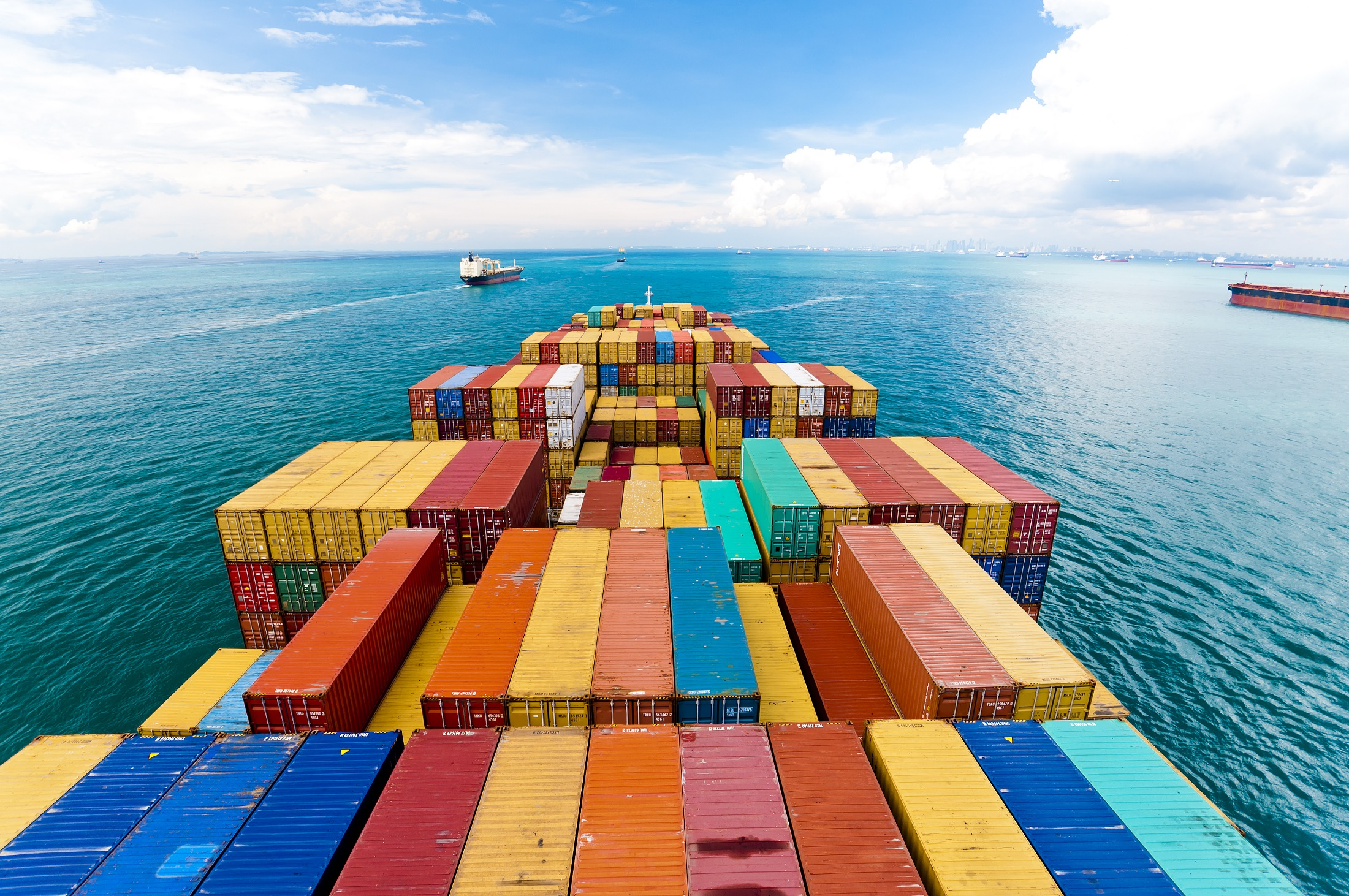
Often, its not so easy..
HOW TO FIND A CONTAINER LIKE DAT?
Notes:
So many containers. How do you find the container that contains the data point that you want.

Slide 54
Nesting of Data
Geography
Websites
Country
Html
City
Body
Town
Table
Street
TD (Table Data)
Block
Span
Notes:
Go back to first-principles.

Slide 55
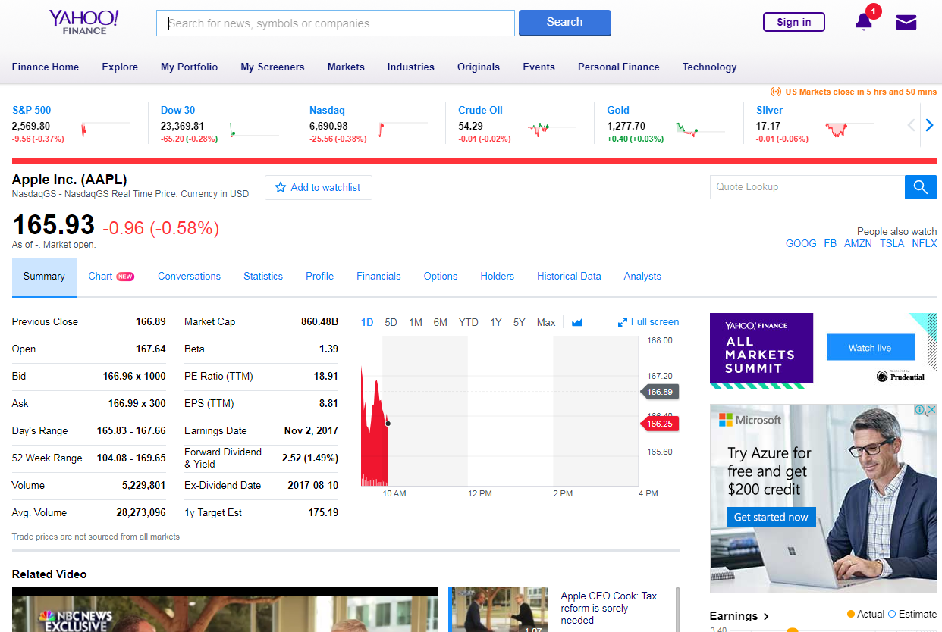
Nesting of Data: Example Yahoo
Notes:
Lets see how a REAL website looks like.

Slide 56
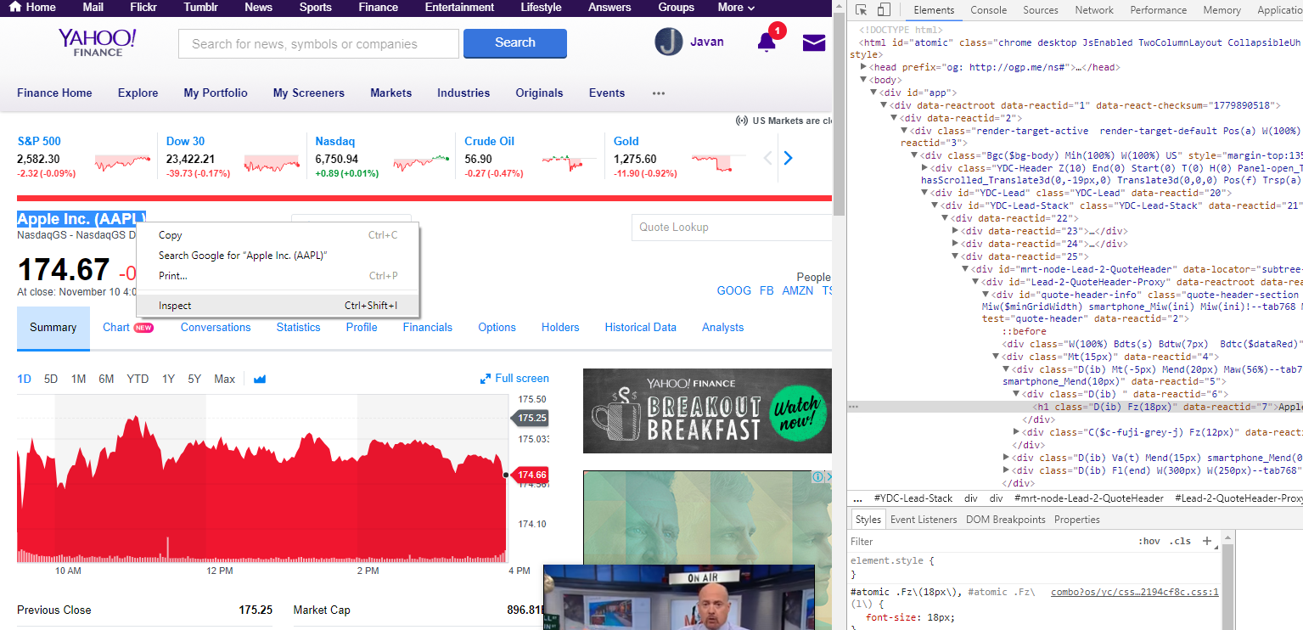
A Big Thank You to Community
Using Google Chrome: Developer Tools
Yahoo Finance – AAPL (Apple Inc)
Select Company Name
Right-click > Inspect
Notes:
Do a short demo of Google developer. Ask them to try it out

Slide 57
Team Challenge
Scraping Real-time Data from Yahoo Finance
90 minutes

Slide 58

Team Challenge Rules!
Earn as many gold coins as possible by completing challenges!
Spend your gold coins effectively to finish your challenges quickly!
*Note: Challenges must be completed in sequence
x 2 : Challenge 1
x 3 : Challenge 2
x 4 : Challenge 3
x 5 : Challenge 4
Free : Use training materials
x 1 : Seeking help from another sub-team
x 2 : Ask facilitators

Slide 59
Prizes
Overall Best Pitch
Best Salesman
Group with the Most Outstanding Pitch
(By Popularity)
Overall Best Group
Techie Masters
Group with the Most Number of Gold coins
Best Team in the Group
Techie Buddies
Team with the Most Number of Gold coins
Best Participant in the Group
Tech Guru
Most Outstanding Participant in the Group
(Decided by TD Emcees and Game Masters)

Slide 60
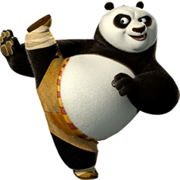
Notes:
See trainer-guide Level 04

Slide 61
Jupyter: Integrated Python/Rebot
Click on challenge.ipynb to start the challenge!
Teams of 3
Complete challenges in sequence
Notes:
See trainer-guide Level 04

Slide 62
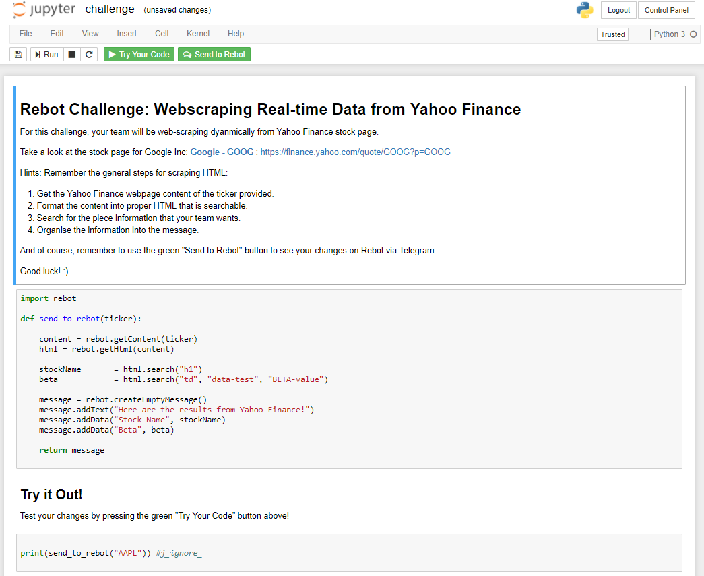
Instructions
Notes:
See trainer-guide Level 04

Slide 63
Hints & Recap
HTML - NESTED CONTAINERS
HTML - CODE BLOCKS
HTML - RAW CODE
Container (HTML)
<HTML>
</HTML>
<HTML>
<BODY>
<P CLASS=“Text”>
Hello World! </P>
</BODY>
</HTML>
Container (BODY)
<BODY>
</BODY>
Container (P)
<P CLASS=“Text”>
Hello World!
</P>
These values are enclosed in tags (think of containers).
They are the basic building blocks needed used to build basic to complex websites.
data = html.search("p", "class", "text")
Notes:
Recap – HTML made of Containers, and Containers of Containers

Slide 64
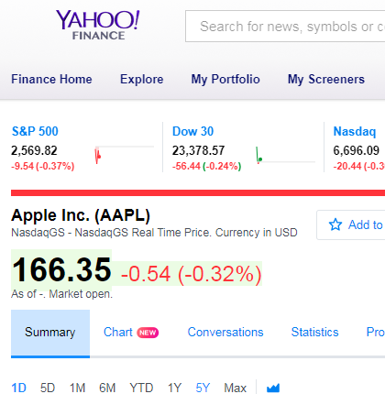
Hint A
<h1
class="D(ib) Fz(18px)"
data-reactid="7">
Apple Inc. (AAPL)
</h1>
Solution:
data = html.search(“h1", "class", "D(ib) Fz(18px)")
Notes:
Solution is at the bottom of this slide

Slide 65
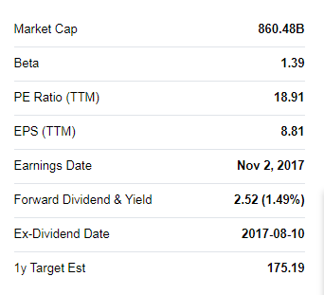
Hint B
<td
class="Ta(end) Fw(b) Lh(14px)"
data-test="BETA-value"
data-reactid="89">
<span
class="Trsdu(0.3s) "
data-reactid="90">
<!-- react-text: 91 -->1.39<!-- /react-text -->
</span>
</td>
Solution:
data = html.search(“h1", “data-test", " BETA-value")
Notes:
Solution is at the bottom of this slide

Slide 66
Good Luck!

Slide 67
Team Challenge Round
*Your team must complete challenges in sequence
Challenge 1
Get the following information
Company Name
Ticker Price
Challenge 2
Get the following stock indicators
Beta
PE Ratio (TTM)
EPS (TTM)
Challenge 3
Give a recommendation if the following conditions are satisfied:
Beta >= 1.5 – “RISKY”
Beta < 1.5 – “SAFE”
Challenge 4
Get the latest news headline
Notes:
See trainer-guide Level 04

Slide 68
Resources

Slide 69
Notes:
So we have covered all four levels. Now they are Code-Fu Masters

Slide 70
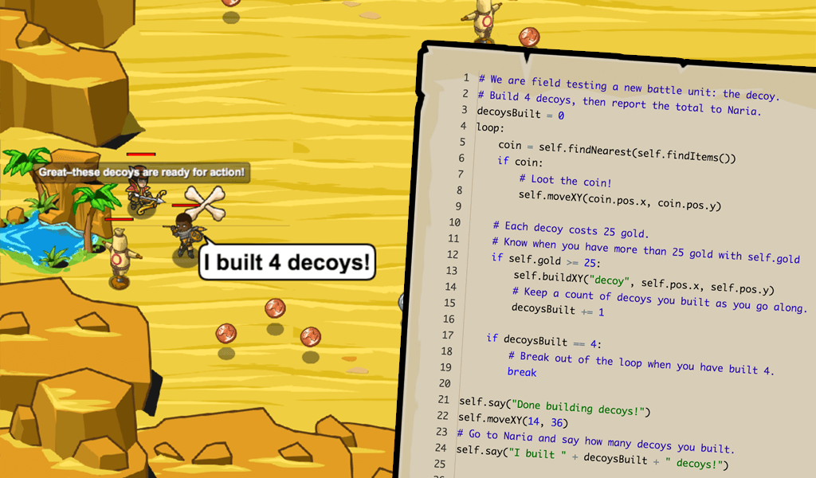
CodeCombat.com
CodeCombat is a fun browser-based coding game that teaches programming. In order to advance through the game's levels, players must prove their knowledge by writing code.

Slide 71
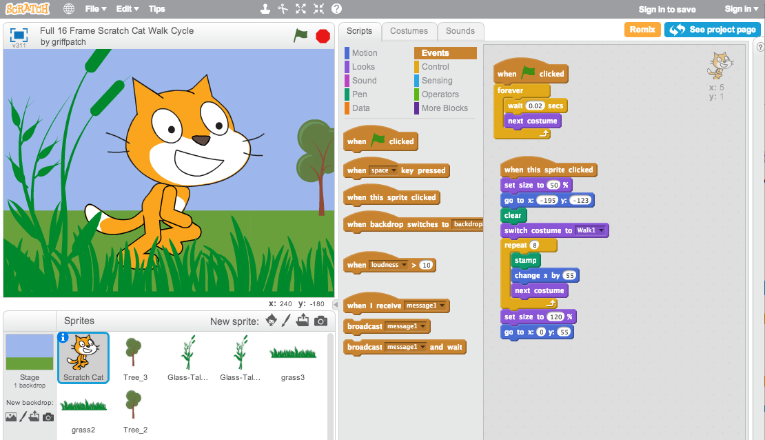
Scratch.mit.edu
Scratch was created by MIT to help people learn to think creatively, reason systematically and work collaboratively. You can use it to create and publish interactive stories, animations, games!

Slide 72
Pitch Perfect
45 minutes

Slide 73
Sell Your Idea !
2 Teams merge into 1 Big Team (6 people)
In your big teams, in the next 10 mins, think of any data & tech idea that you want to sell to the rest.
It may or may not be directly related to your work
It could be an idea to automate or improve efficiency
It could be an enhancement to an existing product (eg: Tableau dashboard, REKI)
Free format – Do a Skit? Flip Charts? Just Talk?
Each team will be given 3 minutes to present

Slide 74

Pick 2 teams
Finally, pick 2 teams to represent your group in the final round in 38th Auditorium.

Slide 75

Notes:
Ask Gamemaster for help to rearrange teams into groups of 6. So there will be 7 new teams x 6 people each.
Idea generation 7 groups of 6 - 15min
Pitch - 2 x 7 mins - 15min
Choose best 2 ideas – 5-10min

